Slide 1
CHANCE OF UNIVERSITY ADMISSIONS PREDICTION
Michelle Badalov, Saima Ahmed, Tamar Kellner, Zeynep Yilmazcoban

Slide 2
FINANCIAL BURDEN OF COLLEGE APPLICATIONS
$50
5-8
Average Cost of a College Application
College Board’s Recommended # of Applications

Slide 3
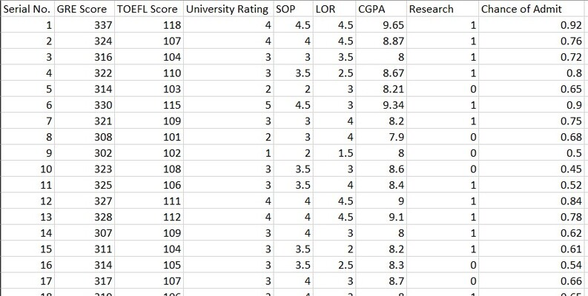
OUR DATASET
Data for Admission in the University from Kaggle:
https://www.kaggle.com/datasets/akshaydattatraykhare/data-for-admission-in-the-university

Slide 4
Admissions is a binary decision: Yes or No

Slide 5
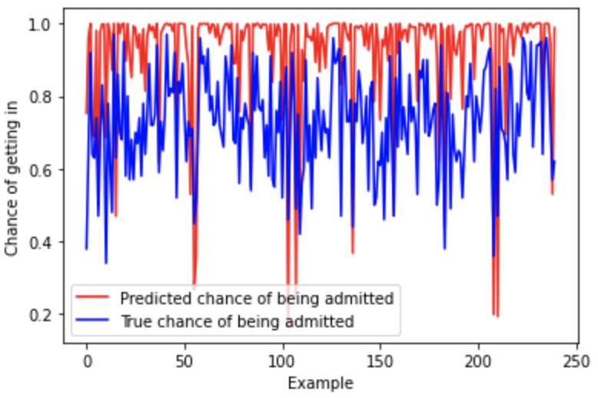
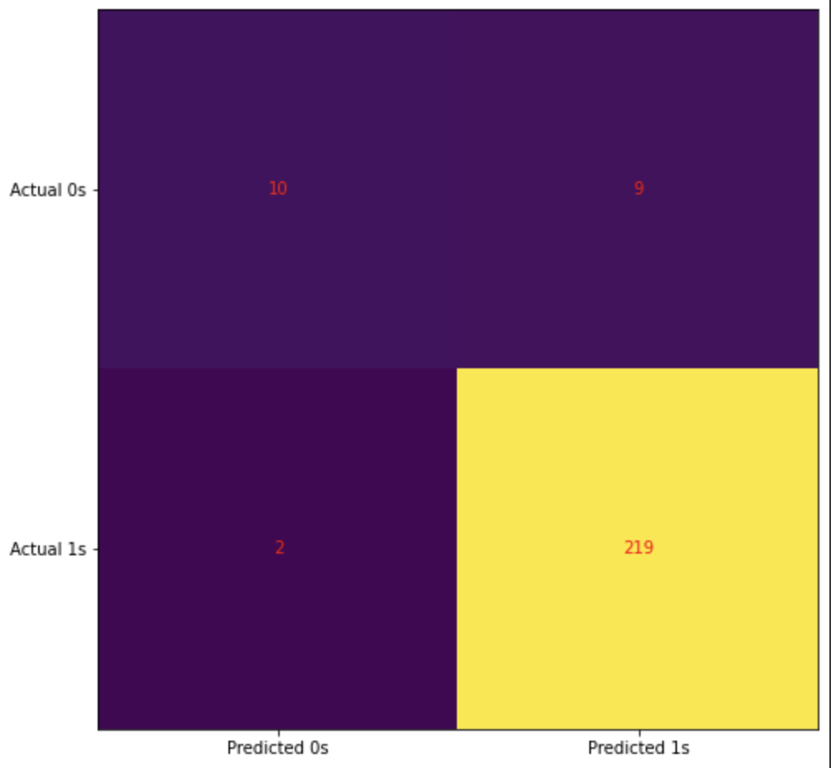
BINARY CLASSIFICATION
Trained a logistic regression model using sklearn’s Logistic Regression.
Accuracy of the model on testing data is ~94%.
True vs. Predicted Chance of Admission
Confusion Matrix

Slide 6
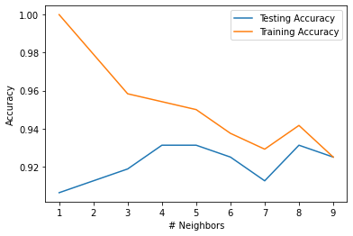
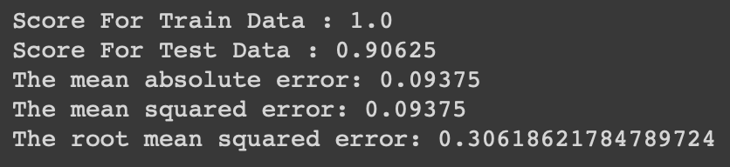
BINARY CLASSIFICATION
Trained a KNN model using KNeighborsClassifier from the sklearn library
Trained a Decision Tree Classifying model using DecisionTreeClassifier from the sklearn.tree library
Accuracy of the model on testing data is highest (~93%) when k = 4

Slide 7
Model Comparisons
Classification Method | Test Accuracy
Logistic Regression | 0.94375
KNN (k=4) | 0.93125
Decision Tree | 0.90625

Slide 8
Future Motivations
Expand our model to train on multiple classes
Create clusters based on student features to determine which types of schools students are most likely to get into
Tier the schools based on acceptance rate
Test models on dataset with final admission decision rather than likelihood

Slide 9
Thank You! Questions?

